Slide 1

Business Analytics Nanodegree
Query a Digital Music Store Database | Project 3

Slide 2
Project Description
In this project, I worked with Query a Digital Music Store Database. I only used a SQL query to manipulate and analyze the data to get out with some insight. After that I used Excel sheet to visualize the data and write a short summary.

Slide 3
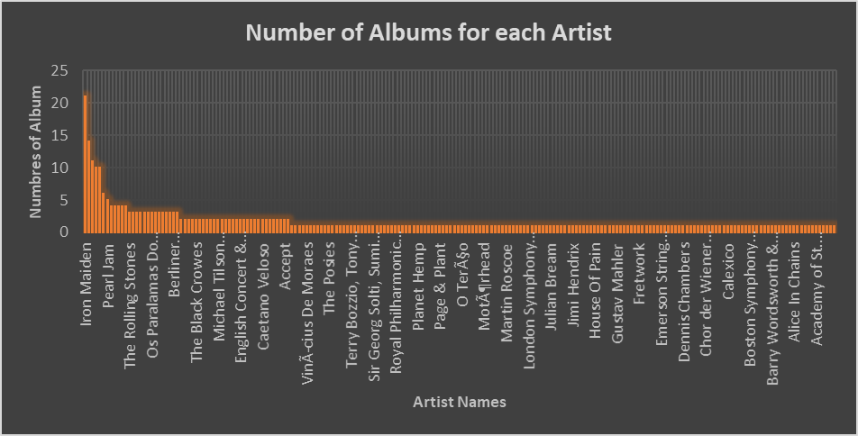
Who is the artist that has the highest number of albums?!
Iron Maiden is the artist that has the heights number of albums. He has 21 albums.
Led Zeppelin followed by iron with 14 albums.

Slide 4
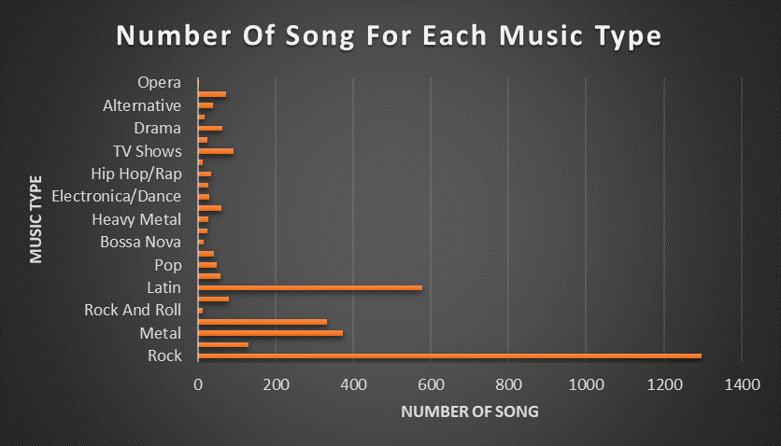
How Many Songs For Each Music Type (Genre) ?!
The bar chart shows the number of songs for each music type.
Rock has 1297 songs and that is the largest number of songs for one music type, While opera has one song and that is the lowest number.

Slide 5
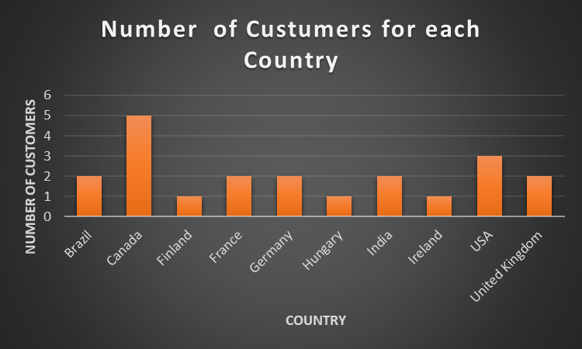
How many customer that Sales Support Agent “Jane” responsible ?! Where are they from?!
Sales Support Agent “Jane” was responsible for 21 customers in 10 different countries.
In Canada she has five customers. In the United Kingdom, she has 3. Also, she has two customers in Brazil, France, Germany, and India. And in Hungary and Finland, she has one customer.

Slide 6
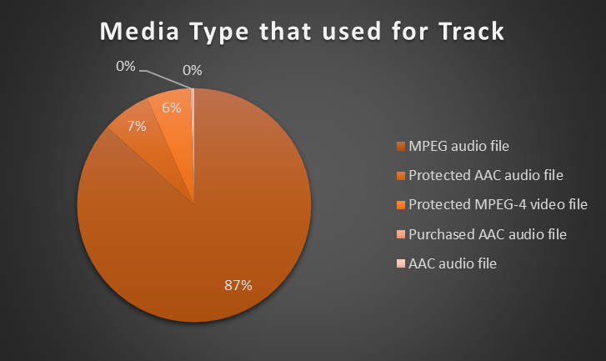
Media Type that used for Track
MPEG audio file is the most used track for songs. There are a 3034 song that used the MPEG audio file.
AAC audio file (11 songs )and Purchased AAC audio file (7 songs) have the lowest track used.

